Slide 1
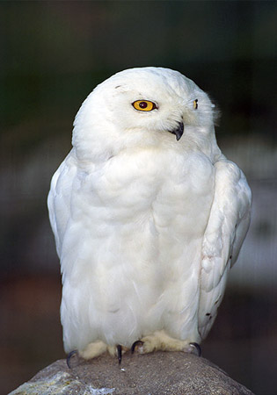
Drivers of Avian Local Species Richness
Student names removed for anonymity

Slide 2
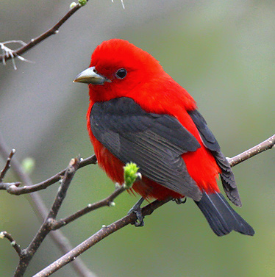
Hypothesis
There will be greater species richness at the longitudes closer to the coast line.
There will be more species of birds where there is a greater proportion of forest land-cover.

Slide 3
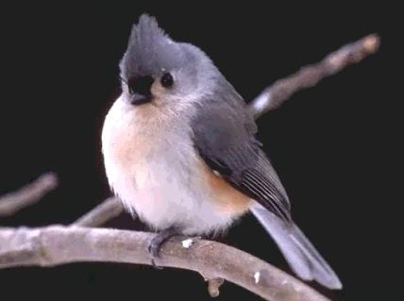
Method Specifications
The latitude points were kept at +-5˚ of 40˚N to limit the effect of latitudinal factors.
The longitudes ranged from -105.72 and -74.06 to show the inland and costal effects on species richness.

Slide 4
Site | Point | State | Latitude | Longitude | Surveys per Year | Years Surveyed | Bird Species
NE Iowa | 16-A | Iowa | 43.455 | -91.349 | 6 | 2 | 25
Ozark-St. Francis Nat. Forest | A | Arkansas | 35.817 | -93.073 | 5 | 3 | 5.6
KY Fish and Wildlife | PSF-17 | Kentucky | 37.098 | -87.668 | 11 | 11 | 11.8
Missouri Private Lands Restoration Site | Drake 1 | Missouri | 36.671 | -91.823 | 9 | 3 | 3
Horicon NWR | 10 | Wisconsin | 43.616 | -88.673 | 3 | 3 | 15
Big Oak NWK | BBS-D | Indiana | 38.988 | -85.453 | 1 | 1 | 12
Big Oak NWK | BBSA12 | Indiana | 38.903 | -85.425 | 7 | 7 | 8
Big Oak NWK | BBSA17 | Indiana | 38.936 | -85.43 | 7 | 7 | 9
Big Oak NWK | BBSCO6 | Indiana | 38.869 | -85.442 | 6 | 7 | 14
Big Oak NWK | BBSD13 | Indiana | 39.038 | -85.424 | 6 | 7 | 8
Edwin B. Forsythe NWR | 73 | New Jersey | 40.039 | -74.088 | 9 | 10 | 6.2
Edwin B. Forsythe NWR | 75 | New Jersey | 40.042 | -74.061581 | 4 | 5 | 5.6
Erie NWR | GLSL20 | Pennsylvania | 41.571 | -79.976 | 23 | 6 | 13.5
Ohio River Islands NWR | ORIN50 | West Virgina | 39.886 | -80.79 | 5 | 5 | 7.6
Ohio River Islands NWR | ORIN46 | West Virgina | 39.89 | -80.795 | 5 | 5 | 8.2
Upper Mississippi River | 201-1 | Iowa | 43.64 | -91.58 | 2 | 2 | 9.5
Fergus Falls WMD | aga-2 | Minnesota | 46.28 | -96.24 | 1 | 1 | 6
Squaw Creek | Wet Prarie 01 | Kansas | 37.25 | -95.77 | 9 | 4 | 8.5
Neal Smith NWR | 1 | Iowa | 41.6 | -93.3 | 8 | 7 | 3.5
Hamden Slough NWR | 1 | Minnesota | 46.89 | -95.95 | 11 | 8 | 4.25
Rocky Mt. National Park | 101 | Colorado | 40.35 | -105.6 | 6 | 9 | 8
Rocky Mt. National Park | 220 | Colorado | 40.362 | -105.8 | 9 | 9 | 6
Rocky Mt. National Park | 1201 | Colorado | 40.218 | -105.537 | 2 | 9 | 11
Rocky Mt. National Park | 601 | Colorado | 40.404 | -105.721 | 9 | 9 | 6
Rocky Mt. National Park | 4211 | Colorado | 40.427 | -105.5 | 8 | 8 | 5

Slide 5
Local Scale Proportional Land Use
Forest | Non-Forested Wetland | Agricultural | Residential
1.00 | 0.00 | 0.00 | 0.00
1.00 | 0.00 | 0.00 | 0.00
0.99 | 0.00 | 0.00 | 0.00
0.44 | 0.00 | 0.56 | 0.00
0.00 | 0.00 | 0.00 | 0.00
0.95 | 0 | 0.05 | 0
0.98 | 0 | 0.01 | 0.01
0.93 | 0 | 0.07 | 0
0.99 | 0 | 0.01 | 0
0.97 | 0 | 0.03 | 0
0.96 | 0 | 0 | 0.03
0.25 | 0.2 | 0.04 | 0.5
0.56 | 0.04 | 0.36 | 0.06
0.39 | 0.13 | 0 | 0.48
0.49 | 0.4 | 0.12 | 0.12
0.93 | 0 | 0.04 | 0.03
0 | 0.03 | 0.97 | 0
0.11 | 0.06 | 0.71 | 0.12
0 | 0.02 | 0.68 | 0.3
0.1 | 0.21 | 0.62 | 0.07
0.29 | 0.47 | 0.24 | 0
0.7 | 0 | 0.09 | 0
0.9 | 0.03 | 0.07 | 0
0.1 | 0 | 0.82 | 0.03
0.8 | 0 | 0.2 | 0

Slide 6
Regional Scale Proportional Land Use
Forest3 | Non-Forested Wetland4 | Agricultural5 | Residential6
0.66 | 0.00 | 0.31 | 0.03
0.99 | 0.00 | 0.01 | 0.00
0.38 | 0.02 | 0.52 | 0.08
0.44 | 0.00 | 0.55 | 0.01
0.14 | 0.01 | 0.83 | 0.02
0.7 | 0 | 0.27 | 0.02
0.87 | 0 | 0.12 | 0.015
0.86 | 0 | 0.12 | 0.02
0.73 | 0 | 0.25 | 0.02
0.93 | 0.01 | 0.05 | 0.01
0.21 | 0 | 0.15 | 0.65
0.09 | 0.95 | 0.39 | 0.47
0.51 | 0.05 | 0.3 | 0.14
0.63 | 0.1 | 0.07 | 0.21
0.63 | 0.1 | 0.07 | 0.21
0.39 | 0 | 0.57 | 0.03
0 | 0.05 | 0.93 | 0.01
0.11 | 0.32 | 0.5 | 0.08
0.01 | 0 | 0.95 | 0.04
0.1 | 0.12 | 0.76 | 0.02
0.68 | 0.02 | 0.26 | 0.04
0.55 | 0.01 | 0.07 | 0.01
0.86 | 0 | 0.12 | 0.01
0.49 | 0 | 0.26 | 0.03
0.72 | 0 | 0.27 | 0

Slide 10
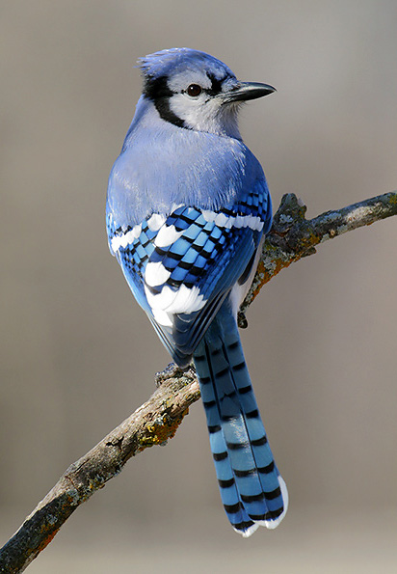
Conclusions
Species richness of avian species decreases as distance from the coast increases.
For both local and regional scales, species richness increases with larger proportion forest land use.

Slide 11
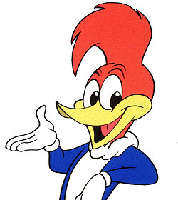
Citations
Date used=10/10/10 (MRLC)
http://www.mrlc.gov/index.php
Date used=10/10/10 (Bird Count)
http://137.227.242.103/point/

